Slide 1





SWE3028-Fall-2024
Capstone Design Project
NLP-based
Psychological Diagnostic Diary
Weekly Progress Meeting (2)
런닝머신 팀(TEAM C)
김나영 김예담 박준현 방기호

Slide 2


CONTENTS
01
Recap
02
Progress
⓵ UX/UI ⓶ Front-end ⓷ AI ⓸ Back-end
03
Challenging Problem
04
Plan
Capstone Design Project

Slide 3










01. Recap
Week 2-3 | Week 4-5 | Week 6-7 | Week 8-9 | Week 10-11 | Week 12-13 | Week 14-15
Topic Ideation
Data Collection
AI Model Design
Data PreProcessing
Model & Algorithm Implementation
UX/UI Design & Implementation
Beta Service & FeedBack
Capstone Design Project

Slide 4
02. Progress – [UX/UI] Branding
마음 Mind
나침반
Compass
Helping users understand their inner selves, reflect on their emotions,
and find their way forward
Capstone Design Project

Slide 5

02. Progress – [UX/UI] Branding
Heart and Heartbeat symbol
+
Compass pin
Capstone Design Project

Slide 6
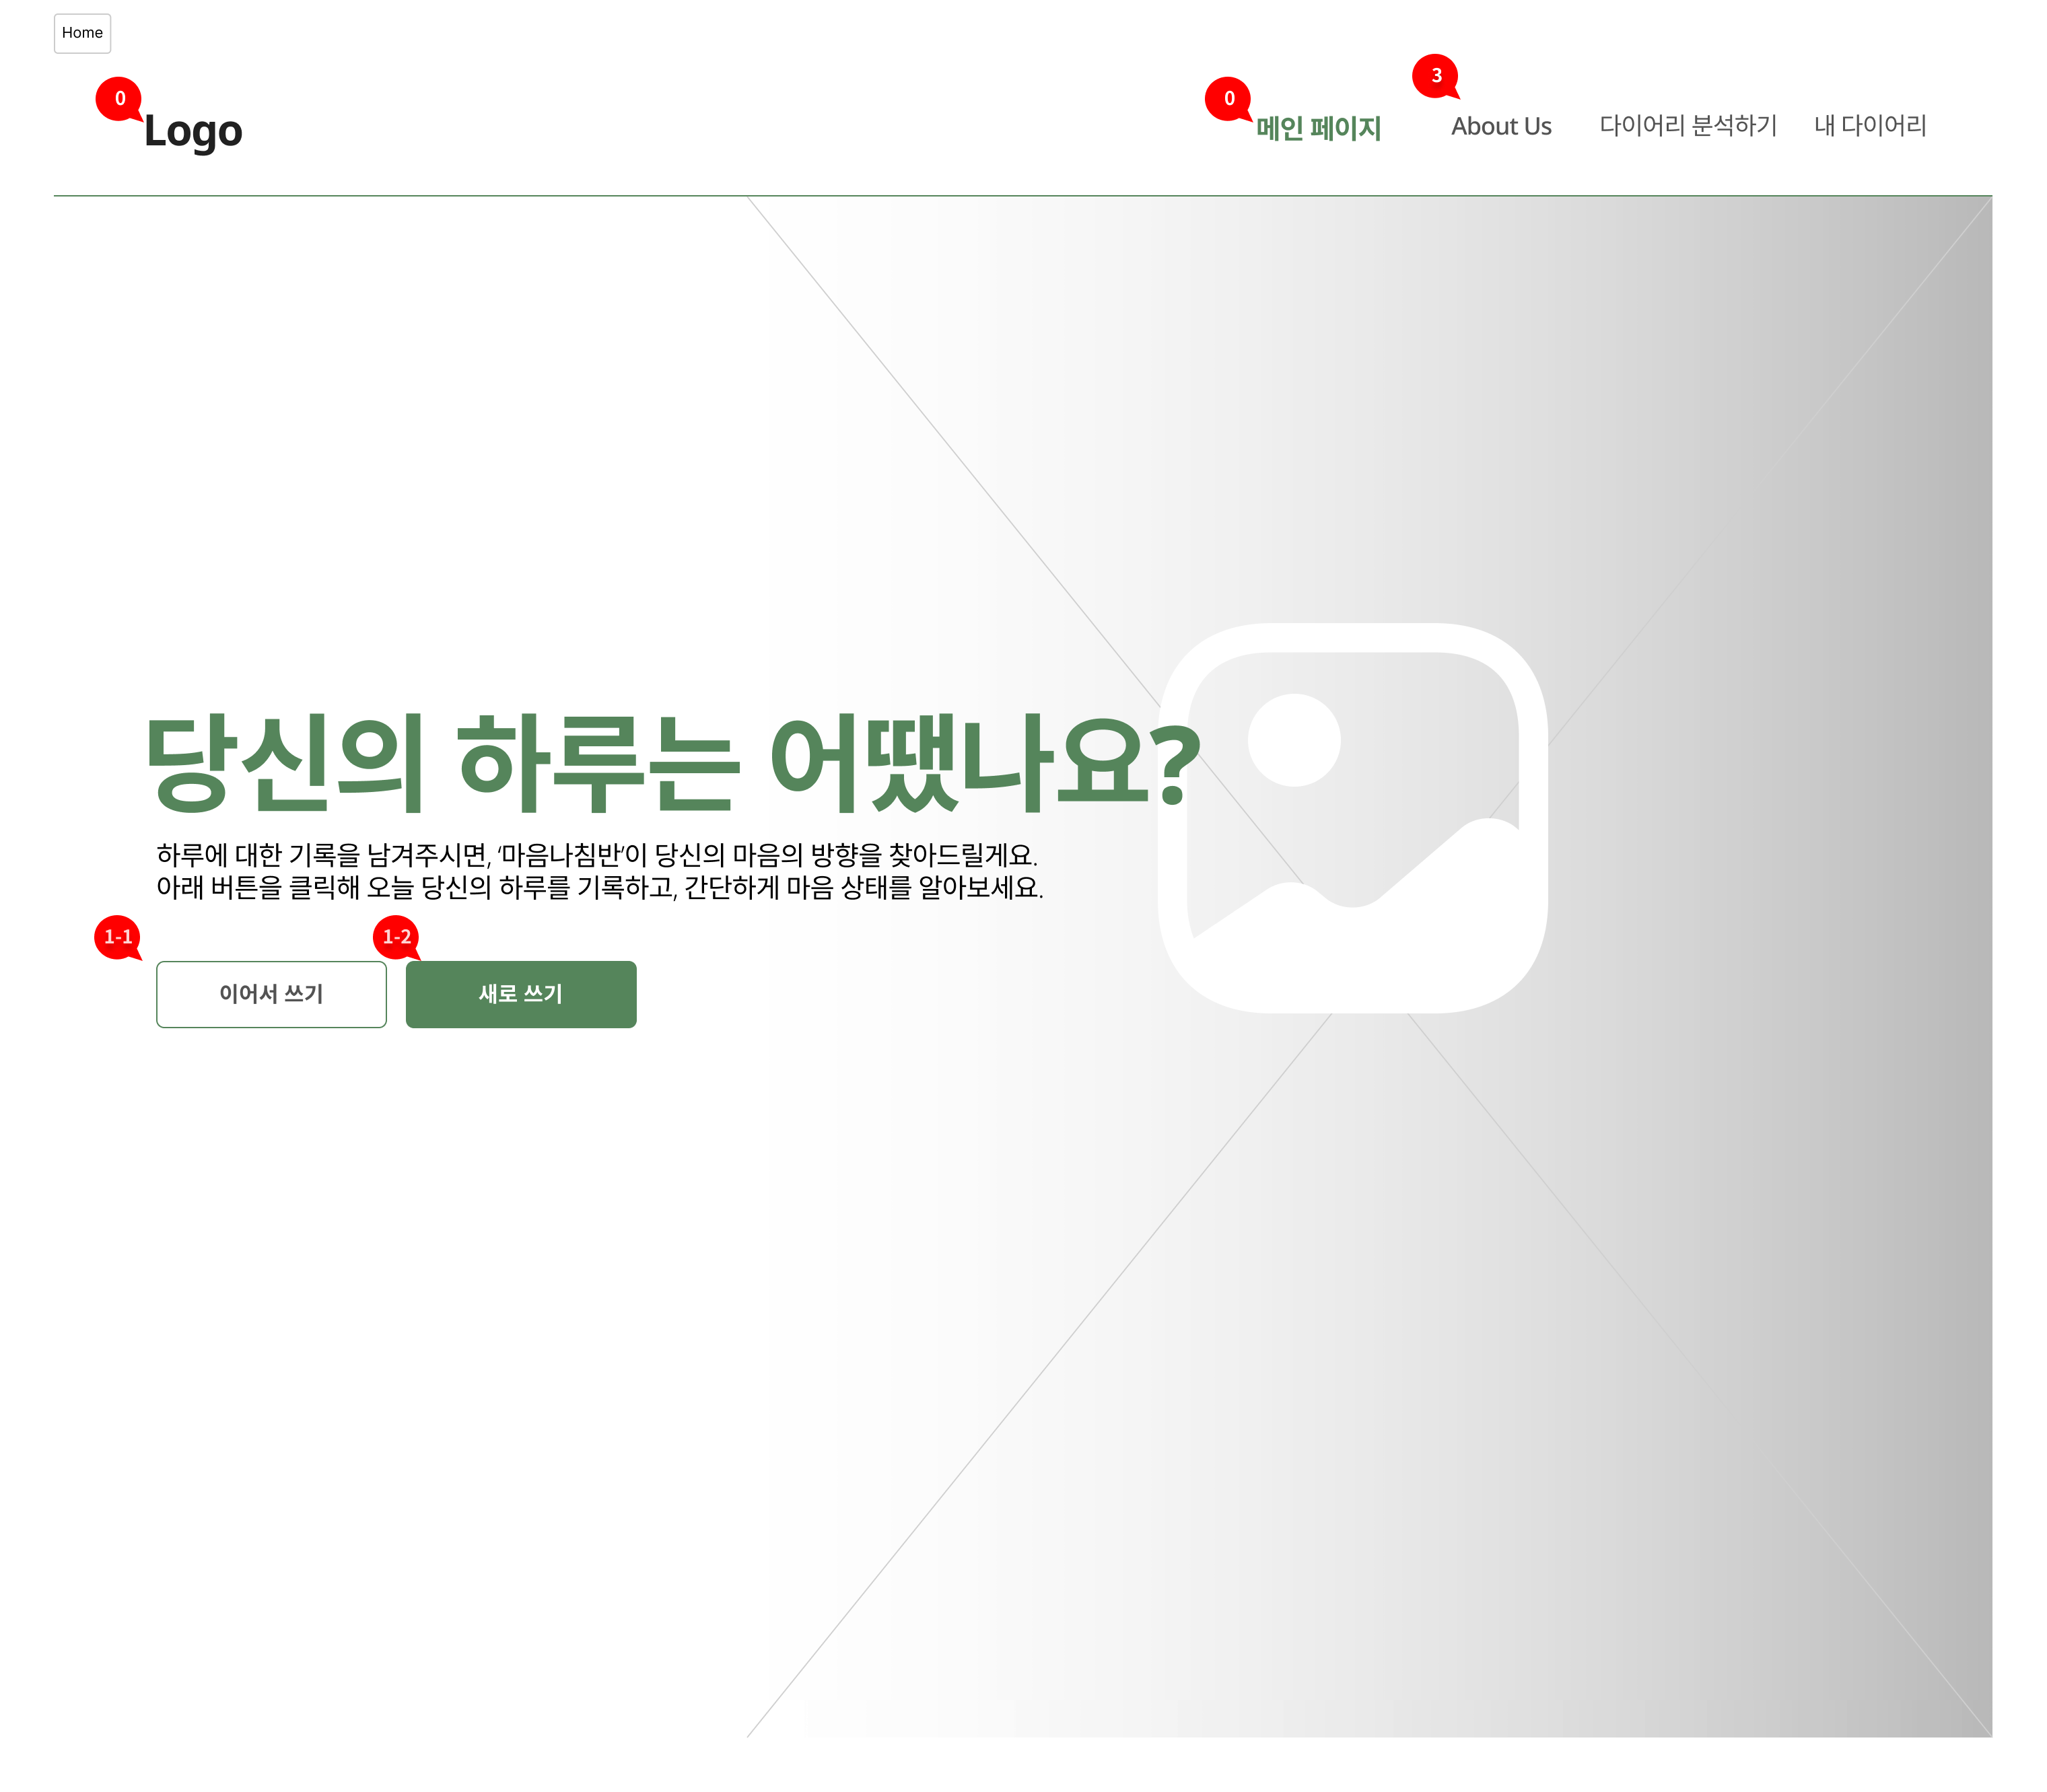
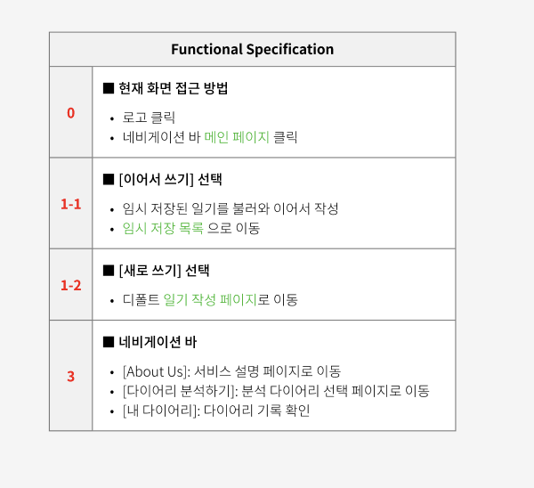
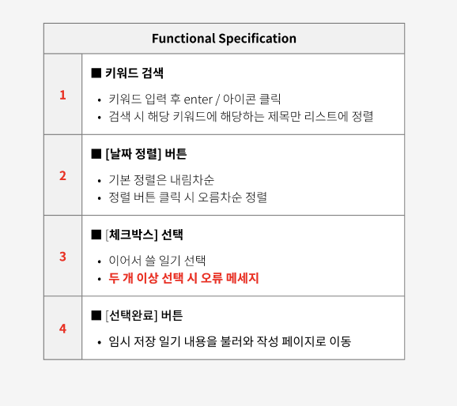
02. Progress – [UX/UI] Function Specify
Capstone Design Project

Slide 7

02. Progress – [AI] Data Augmentation
nervous | 3049
insomnia | 2317
sadness | 2150
...
Data Augmentation
for 8 emotions
with less than 1000 utterances
loneliness | 956
hopeless | 887
suicidal | 727
appetite↑ | 540
concentration↓ | 458
confidence↓ | 445
loss | 439
emotion control↓ | 389
Capstone Design Project

Slide 8
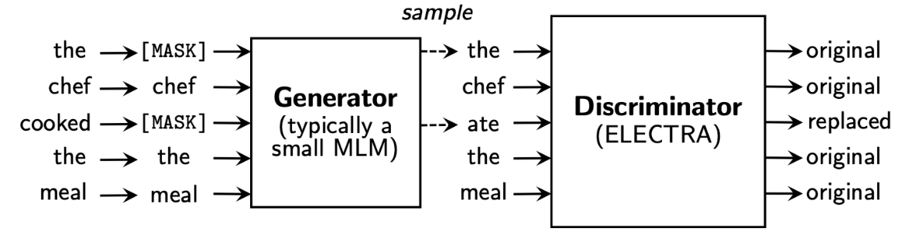
02. Progress – [AI] Data Augmentation
< ELECTRA >
Efficiently Learning an Encoder that Classifies Token Replacements Accurately
Replaced Token Detection (RTD): Binary classification problem
where generator turns some of the tokens into a plausible fake token
and discriminator guesses whether each token is a real or a replaced token
Capstone Design Project

Slide 9



02. Progress – [AI] Data Augmentation
< KoELECTRA >
A natural language model that learns ELECTRA with 34GB of Korean text
Efficient learning structure
Korean-specialized
Capstone Design Project

Slide 10

02. Progress – [AI] Data Augmentation
1. Random Masking Replacement
그런데 완전히 죽기에는 3층이 너무 낮았던 거죠.
Randomly
그런데 [MASK] 죽기에는 3층이 너무 낮았던 거죠.
KoELECTRA's fill-mask pipeline
그런데 이게 죽기에는 3층이 너무 낮았던 거죠.
Capstone Design Project

Slide 11
02. Progress – [AI] Data Augmentation
2. Random Masking Insertion
그런데 완전히 죽기에는 3층이 너무 낮았던 거죠.
Randomly
그런데 완전히 죽기에는 3층이 너무 낮았던 [MASK] 거죠.
KoELECTRA's fill-mask pipeline
그런데 완전히 죽기에는 3층이 너무 낮았던 그런 거죠.
Capstone Design Project

Slide 12



02. Progress - [AI] Data Augmentation
Random Masking
Replacement
Random Masking
Insertion
Vocabulary diversity
-> Different expressions
for context
Various expressions
-> Can be transformed or emphasized
Meaning distortion
-> Meaning of a sentence can be distorted
Limited semantic change
-> Generatesimilar data
Capstone Design Project

Slide 13
02. Progress – [AI] Evaluation Metrics
epoch = 5, batch size = 32, learning rate = 5e-5
 | Test Acc | F1-score | Precision | Recall | Cosine Similarity
base | 0.840 | 0.871 | 0.861 | 0.863 | -
Only Replacement | 0.876 | 0.855 | 0.856 | 0.856 | 0.951
Only Insertion | 0.867 | 0.881 | 0.864 | 0.885 | 0.973
Both | 0.865 | 0.864 | 0.864 | 0.865 | 0.964
Capstone Design Project

Slide 14
02. Progress - [AI] Hyperparameter Tuning
Learning rate: [5e-5, 3e-5]
Batch size: [16, 32]
Warmup ratio: [0.1, 0.2]
Dropout rate: 0.1
Epochs: 5
Max grad norm: 1
Log interval: 200
Max length: 512
Learning rate: 5e-5
Batch size: 16
Warmup ratio: 0.2
Dropout rate: 0.1
Epochs: 5
Max grad norm: 1
Log interval: 200
Max length: 512
Test Acc | F1-score | Precision | Recall | Cosine Similarity
0.865 | 0.864 | 0.865 | 0.865 | 0.989
Capstone Design Project

Slide 15
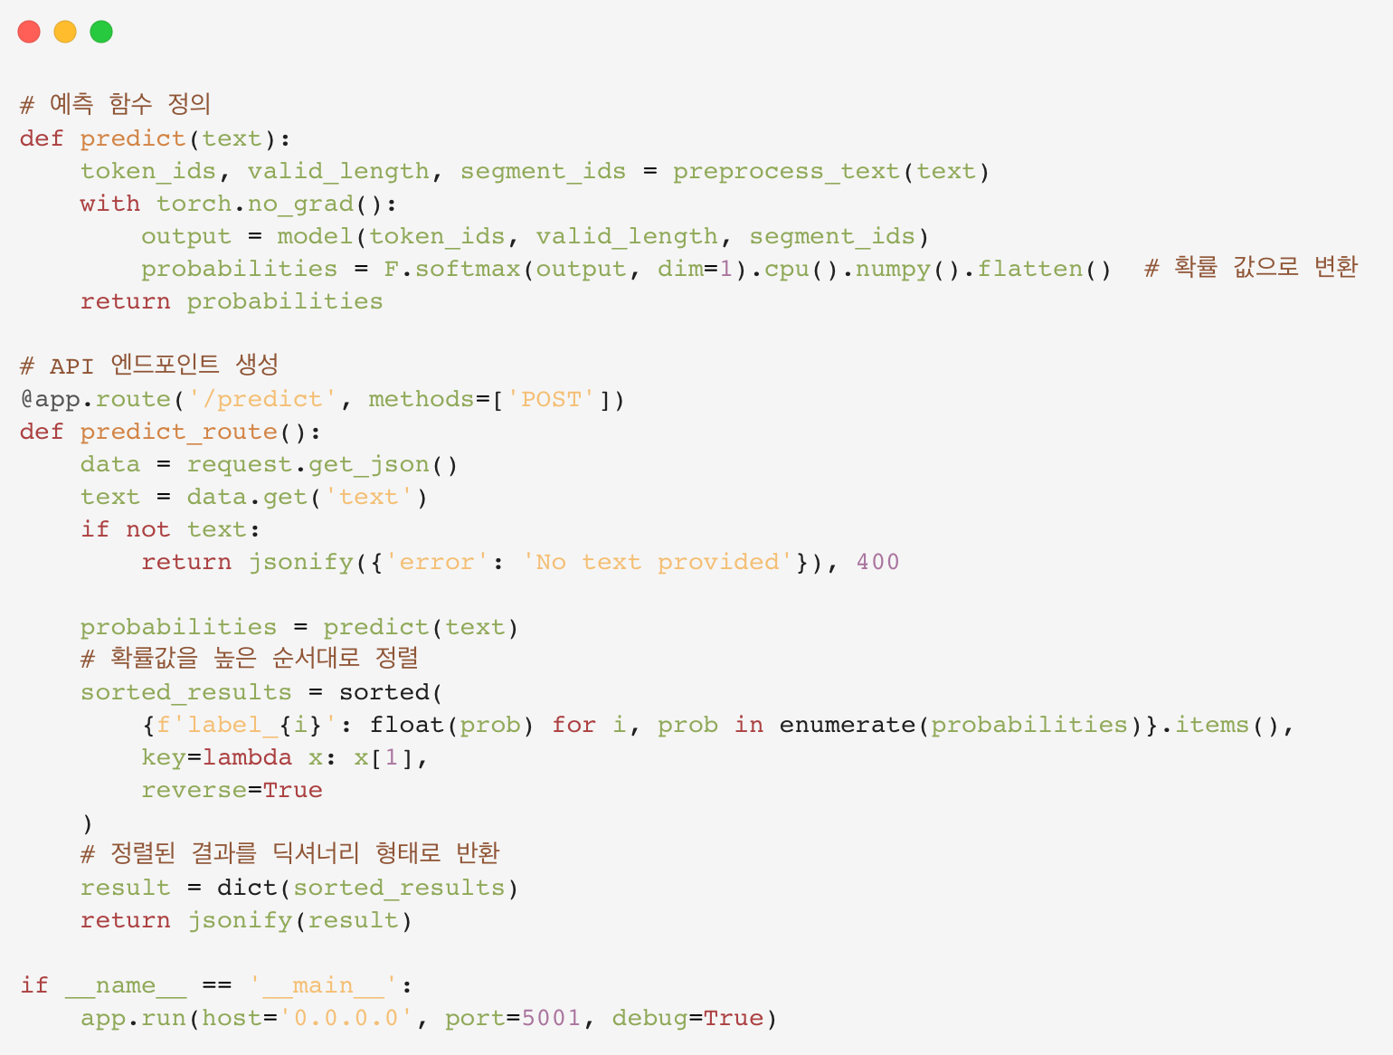

03. Progress - [AI] Model Serving
Capstone Design Project

Slide 16
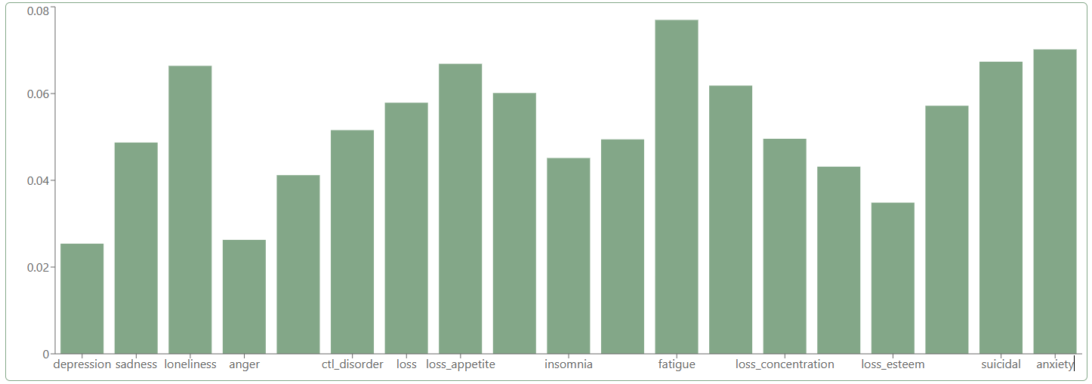

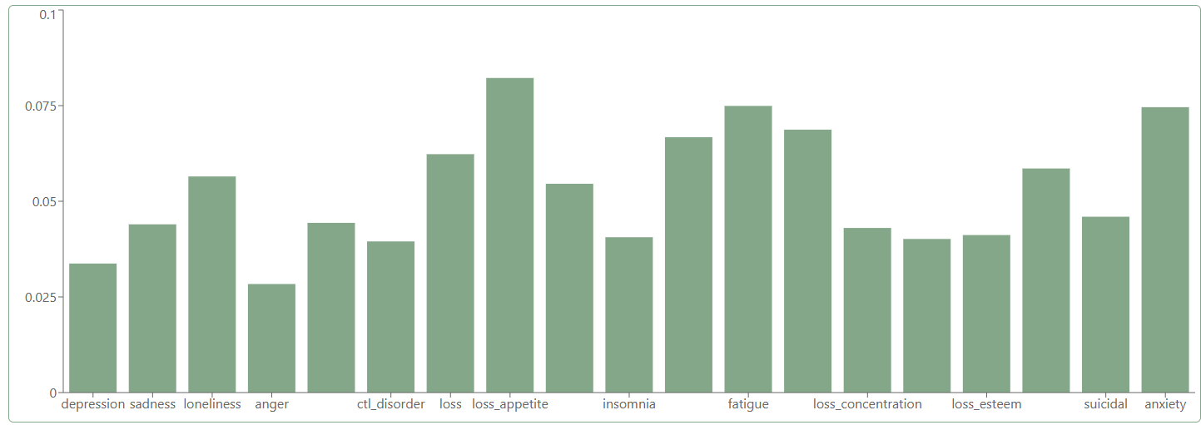
03. Progress - [Front] React-Flask
Experiencing a lot of challenges
and feeling overwhelmed
Experiencing
boredom in life
Capstone Design Project
Notes:
In the frontend, we can now display the data analyzed by the backend as graphs. For the first post, the data given to the backend is about experiencing a lot of challenges and feeling overwhelmed. In the second post, the given data is about experiencing a sense of boredom with life. In the first graph, the largest metric is fatigue, while in the second, it’s loss of appetite. The results seem to align well with the content of each post. However, there are 2 limitations in the graphs. One is that the graph sizes are adjusted relatively, making it difficult to compare data across different posts. Also the other problem is not all the labels under the bar graphs are printed completely.

Slide 17

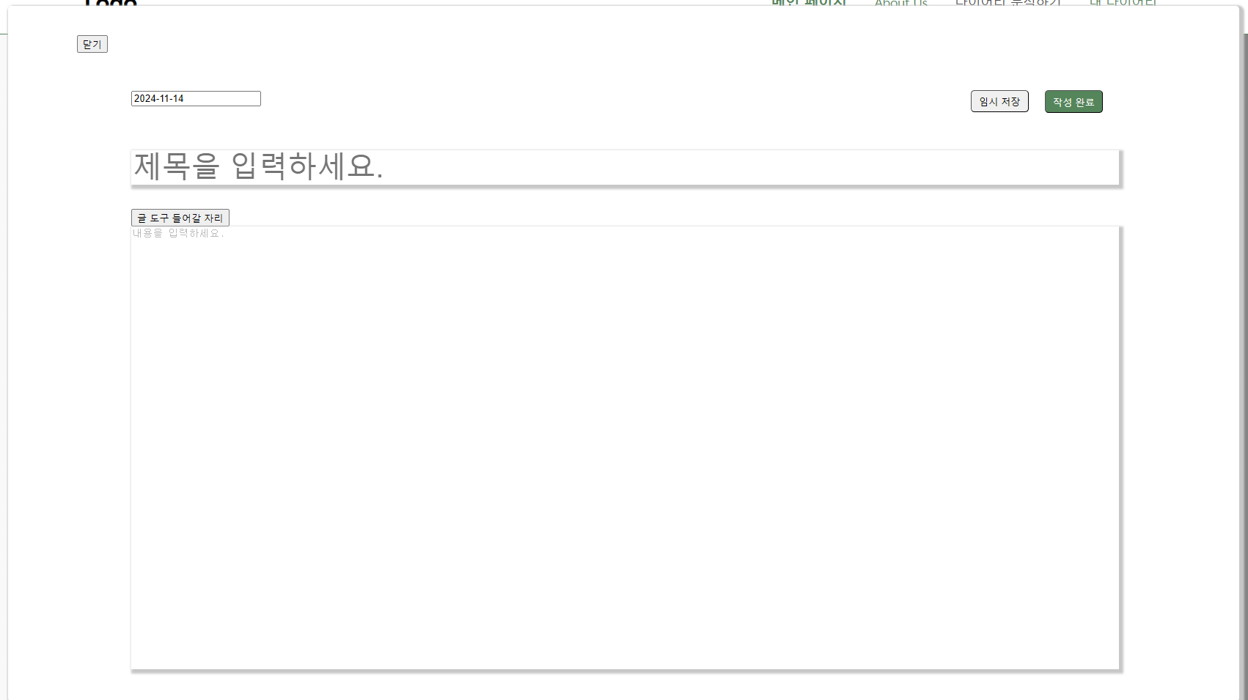
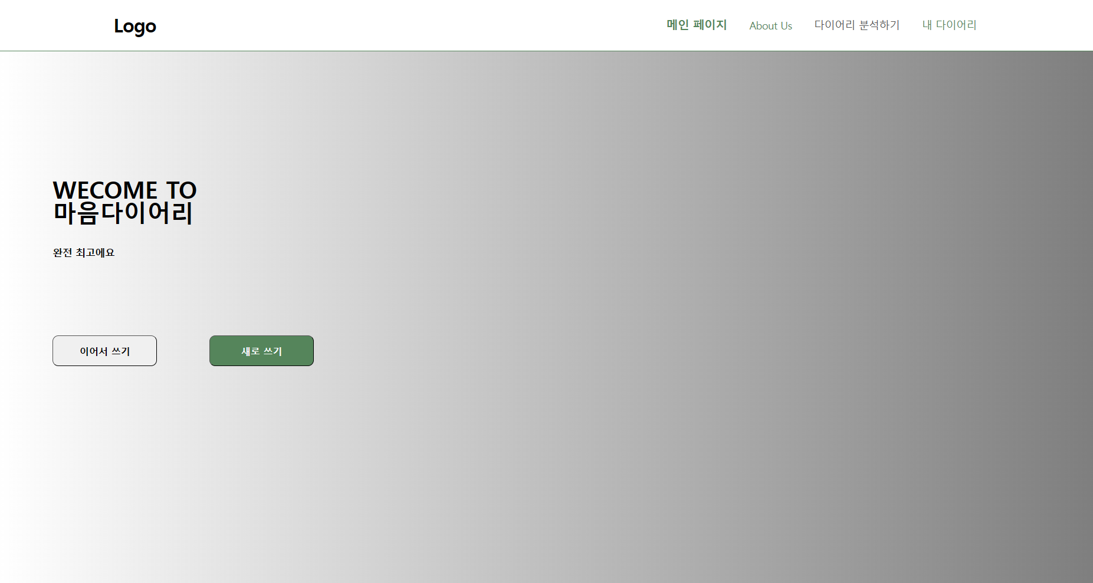
03. Progress - [Front] Build Webpage
Notes:
The Routes Module has been used to assign URLs, allowing direct navigation through the Navbar. Clicking "Main Page" in the Navbar takes you to the main page, where options to either continue writing or start a new entry are available. The “Continue Writing” feature is still under development, but “New Entry” is functional, allowing users to write entries in a modal window. This modal can be closed with a “Close” button or completed with a “Submit” button. Upon clicking “Submit,” the title, content, and date are sent to the backend, where they are saved in the database.
Routes Module을 사용해 주소를 할당했고 Nav바로 바로 이동할 수 있다. nav바의 메인페이지를 누르면 메인페이지로 이동한다. 메인페이지에서는 이어서쓰기와 새로 글쓰기가 가능하며 이어서쓰기의 경우 아직 구축중에 있고 새로운 글쓰기는 Modal창을 이용해 글을 쓰고 이를 백엔드로 보낼 수 있다. Modal창은 닫기 버튼과 작성완료 버튼으로 끌 수 있다. 작성 완료를 누르면 title, content, date가 백엔드로 넘어가 db에 저장된다.

Slide 18

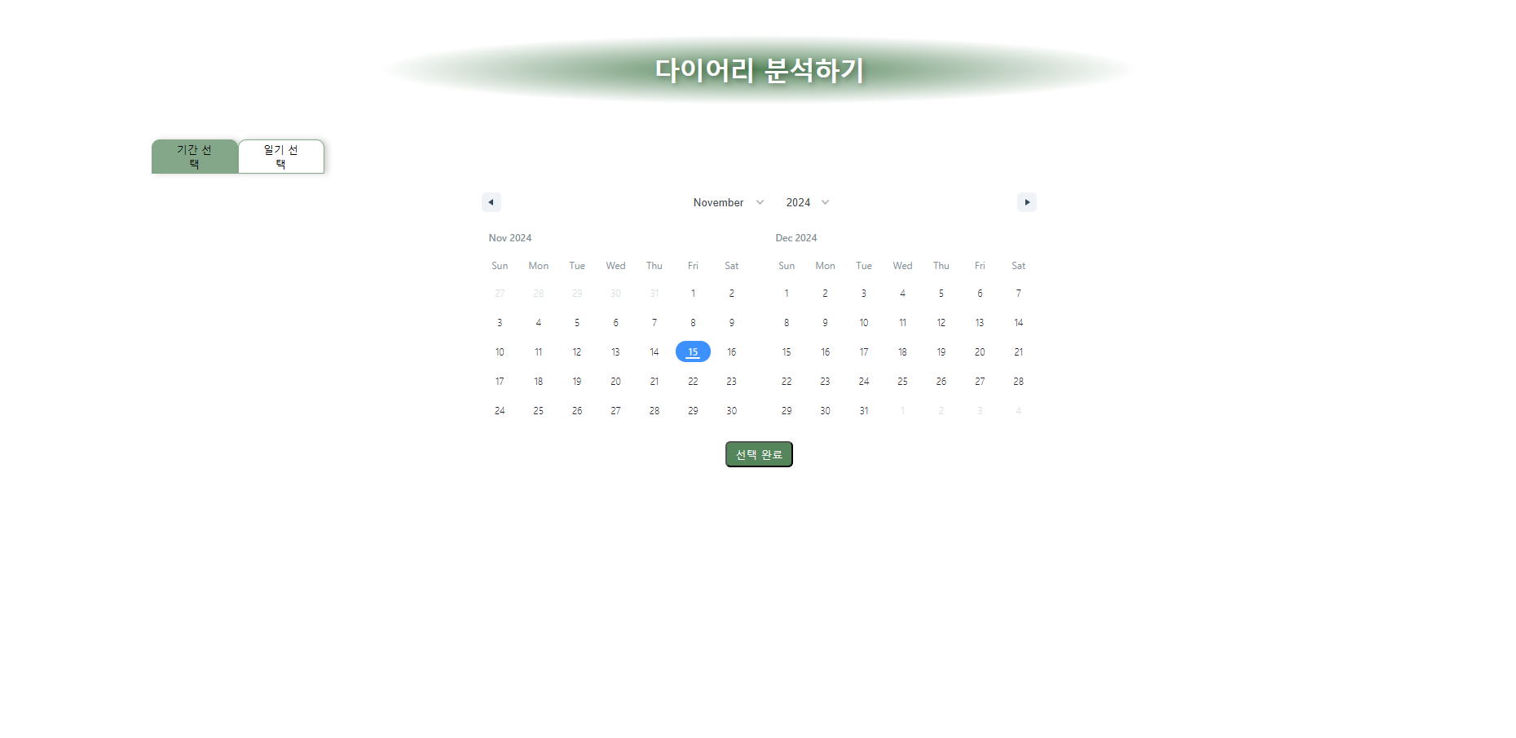
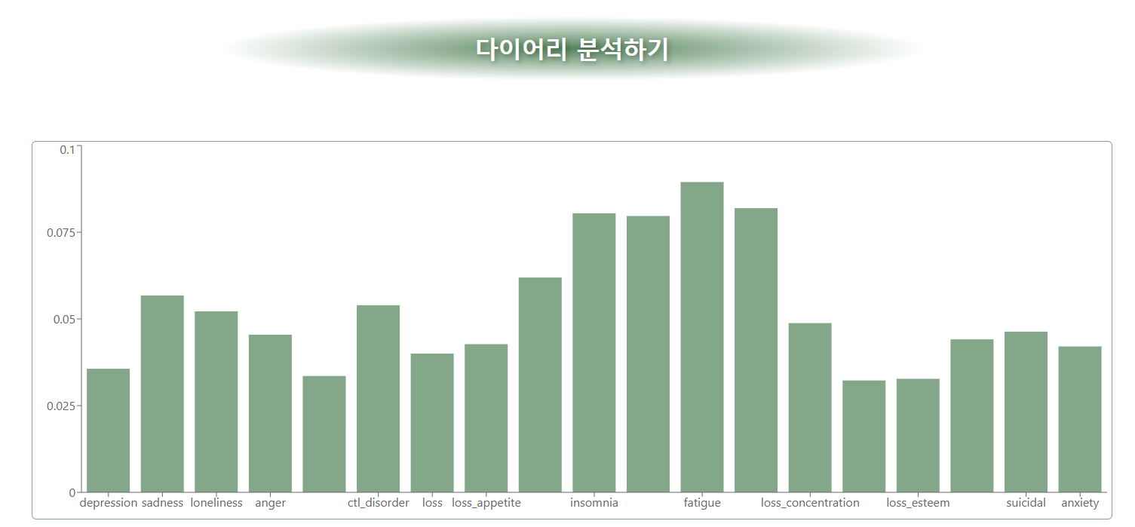
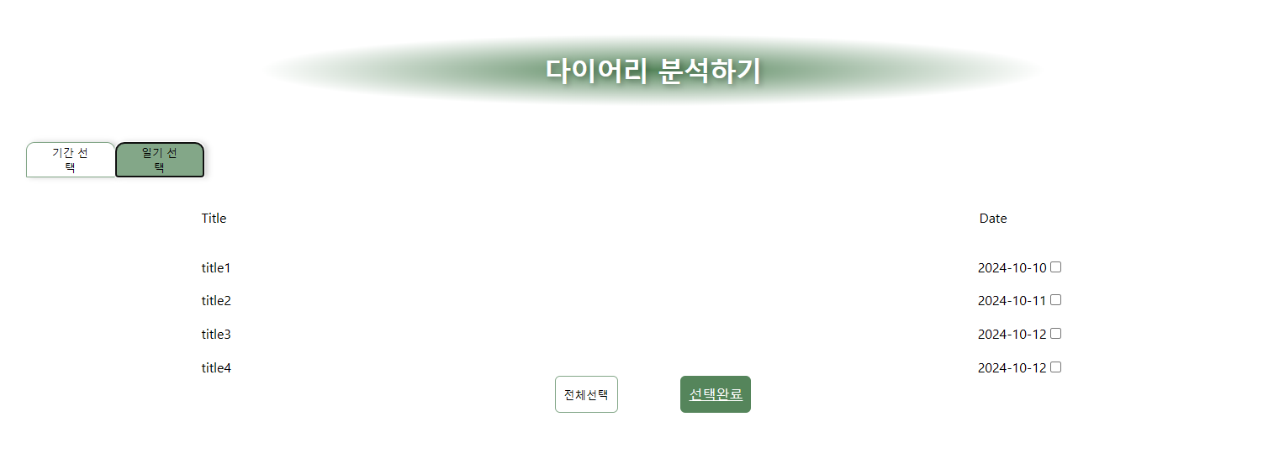
03. Progress - [Front] Build Webpage
Notes:
When "Analyze Diary" is clicked in the Navbar, it navigates to the Diary Analysis page. This page consists of a date range selector and a diary selection tab where users can choose entries within the selected period. Currently, the date selector displays only a calendar without any functional capabilities. Once the feature is complete, users will be able to view only diary entries from the chosen date range in the diary selection tab. For now, all diary entries are displayed in this tab. The page is maintained using a tab component, where the color of the selected tab changes to green. Since the page is no longer the main page, the Navbar color changes to grey. After selecting an entry and pressing the “Complete Selection” button, the content of the entry is sent to Flask for analysis. The result is then received and displayed as a graph on a new page as mentioned in frontend-progress. Currently, only one diary entry can be analyzed at a time. In the future, additional functionality will allow for multiple diary entries to be analyzed simultaneously, with the results displayed on a graph for the selected period.
The pages for "About Us" and "My Diary" in the Navbar have not been created yet, as their layouts and contents are still under development.
Nav바에서 다이어리 분석하기를 클릭하면 다이어리 분석 페이지로 넘어간다. 기간선택과 그 기간내의 일기를 선택할 수 있는 일기선택 탭으로 이루어져 있다. 현재 기간 선택의 경우 달력만 구현되어 있고 실질적 기능은 하지 않고 있다. 기능이 완성된다면 기간을 선택한 뒤 그 기간에 작성된 일기만 일기선택 탭에서 볼 수 있게 될 것이다. 현재는 일기선택 탭에는 모든 일기가 올라오고 있다. 탭 component를 활용하여 같은 페이지를 유지한다. 선택한 탭의 색은 초록색으로 변한다. 더 이상 메인페이지에 남아있지 않기 때문에 Nav바의 색이 회색으로 변한 것을 확인할 수 있다. 이후 글을 선택하고 선택완료 버튼을 누르면 frontend-progress에서 설명한 것처럼 그 글의 내용을 flask로 넘겨 분석한 뒤 그 값을 넘겨 받고 그래프가 있는 페이지로 이동을 한 뒤 그 값을 그래프로 표현한다. 현재까지는 한 개의 일기만 분석이 가능하며 이후 기능을 추가해 여러 개의 일기를 한 꺼번에 넘기고 그 기간동안의 분석값을 그래프로 표현할 수 있게 할 것이다.
Nav바 내의 About Us와 내 다이어리는 아직 그 구성이 확정되지 않아 페이지가 제작되지 않았다.

Slide 19
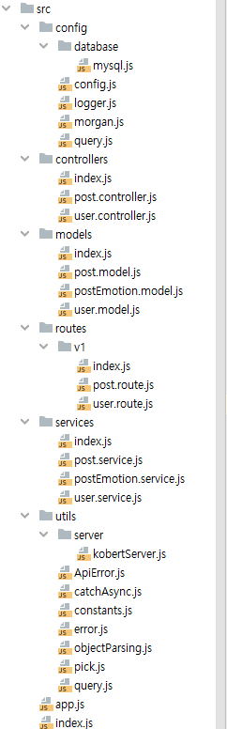

02. Progress – [Back] Development
Framework
Development
Capstone Design Project
Notes:
Here is an update on the progress of the backend. Excluding the AI functionality, the backend for handling the diary feature and user management has been developed. The APIs are organized within the Routes folder, and the main business logic is executed within the Controllers and Services folders. Additionally, information that needs to be stored in the database is organized in the Models folder.

Slide 20
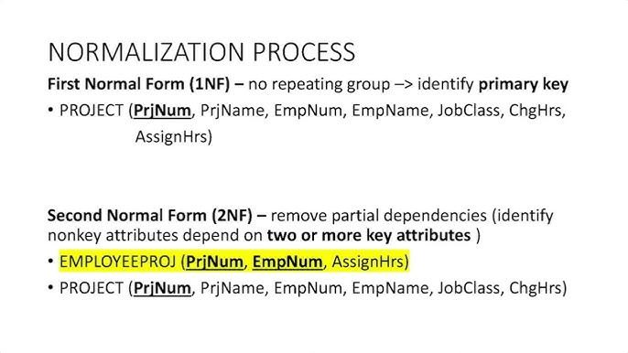
02. Progress – [Back] Normalization
ERD
Normalization
Capstone Design Project
Notes:
Additionally, we are currently in the process of normalizing the existing database. By applying normalization processes, as shown in the examples on the right, we expect to use storage space more efficiently, helping to prevent issues that may arise as the data volume grows.

Slide 21

03. Challenges - Frontend
Capstone Design Project
Notes:
The current challenge is fixing a bug. While passing the analyzed diary data from the backend to another page on the frontend, the page should open twice to work correctly. The values seem pass well from the backend, when we tested. So it looks like a problem on the frontend side. However, Giho in charge of frontend trying to fix the bug, but he is having trouble pinpointing the exact cause and currently facing challenges with this issue. The highest probability is a function that sends data and moves page.
For future plan,

Slide 22

03. Challenges - Back-end
Optimized Database Indexing
Large Data
Make Slow
Data Normalization
Capstone Design Project
Notes:
As a solution to the large data limitations previously mentioned, we are currently normalizing the ERD. The goal of this normalization process is to reduce the potential for data anomalies.

Slide 23



04. Plan
UX/UI
AI
Front-end
Designing Additional Features and Building Wireframes for them
Application of augmentation
for emotion classes
CSS supplementation
Maximize model performance
with hyperparameter tuning
Implementation of unimplemented pages
Back-end
Data Normalization
Capstone Design Project

Slide 24


Q & A
NLP-based Psychological Diagnostic Diary
Capstone Design Project

